Slide 1
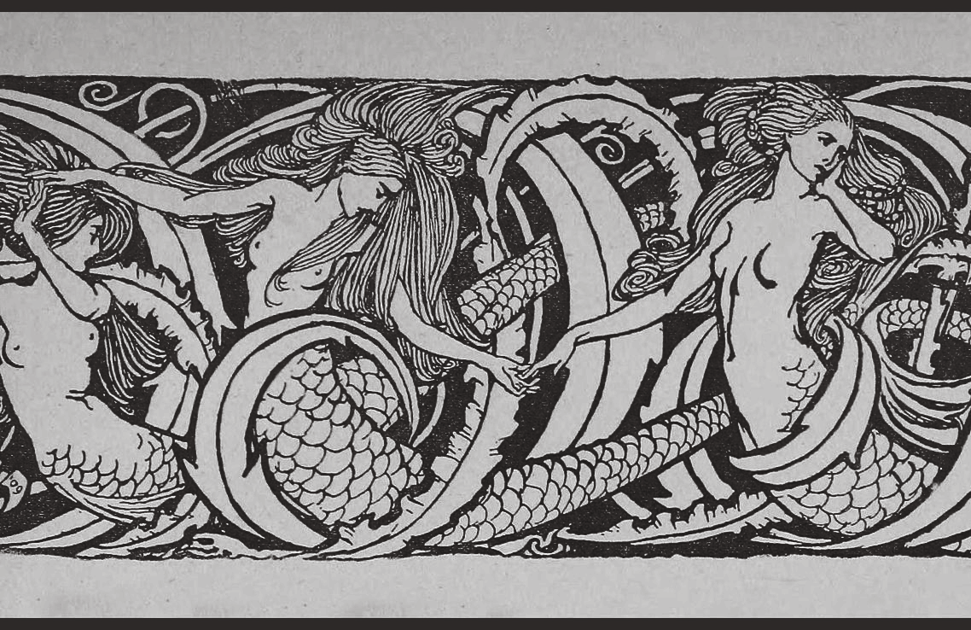

Discrete Fourier Transform unveils decreasing diatonicity and increasing fragmentation in Debussy’s piano music: a diachronic co
Ludovica
Schaerf
rpus study
ludovicaschaerf
IMA Maths in Music Conference,
July 13-15th 2022

Slide 2
Discrete Fourier Transform unveils decreasing diatonicity and increasing fragmentation in Debussy’s piano music: a diachronic co
Small
Large
Outline
Introduction
Corpus
Methodology
Results
Conclusions
Ludovica
Schaerf
rpus study
ludovicaschaerf
IMA Maths in Music Conference,
July 13-15th 2022

Slide 3
I. Introduction
A picture of ambiguity: traits of traditional tonality with a blurred sense of directionality

Slide 4

Introduction
Ondine (1913) Preludes book II, n. VIII

Slide 5
Debussy’s idiom
Introduction
Diatonic materials are blended with or replaced by octatonic, whole-tone, and other chromatic structures. New system based on symmetrical pitch structures, with weakened directionality and ambiguous tonal organization (Tobin, Antokoletz, Salzman)
Fluctuation across different types of pitch structures → fragmented construction. (Wheeldon)
However, the result is not “a confusion of tonal distortions, contradictions and exoticisms” (Parks) → coherent construction

Slide 6
Research question
Introduction
?
Early pieces
Greater use of diatonicity
Little fragmentation across different types of pitch structures
Late pieces
Increasing use of non-diatonic symmetric structures
Greater fragmentation
Does Debussy’s style evolve across his life, moving away from diatonicity towards more varied ways of organizing the pitch space?

Slide 7
Aims and hypotheses
Introduction
Tracing Debussy’s departure from common practice tonality in terms of ambiguity and fragmentation
symmetric pitch-class materials are increasingly salient, whereas asymmetric diatonic scales are decreasingly salient.
the degree of fragmentation for individual pieces increases over Debussy’s life span, yet…
… the degree of coherence does not decrease.

Slide 8
II. Corpus
A novel dataset of Debussy’s entire oeuvre for piano solo (1880-1917) in MS3 format

Slide 9
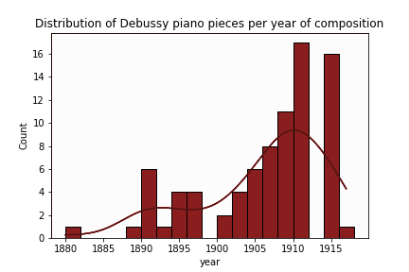
Debussy’s solo-piano works
II. Corpus
We assembled an exhaustive corpus of 82 Debussy’s solo-piano works in MuseScore 3 format
19 of which were typeset for the first time
Suite Bergamasque
Preludes
Book 1
Douze
Études

Slide 10
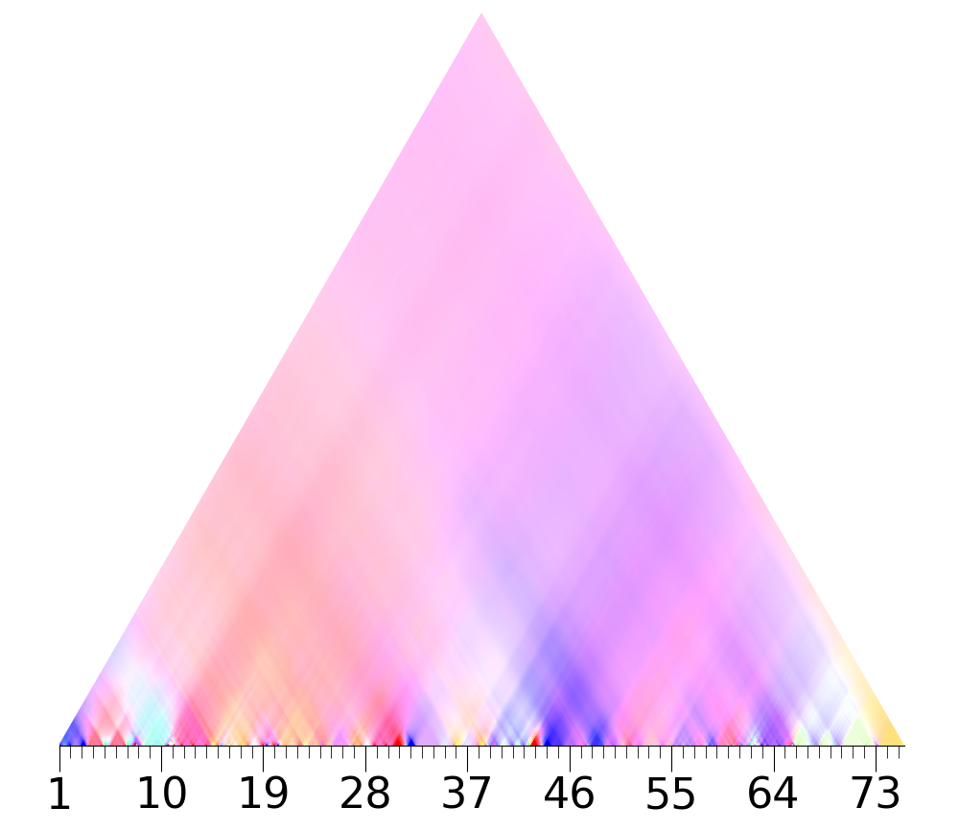
III. Methodology
The DFT as a computational tool for investigating the symmetry properties of pitch collections
Ondine, Wavescape (4th coefficient)

Slide 11
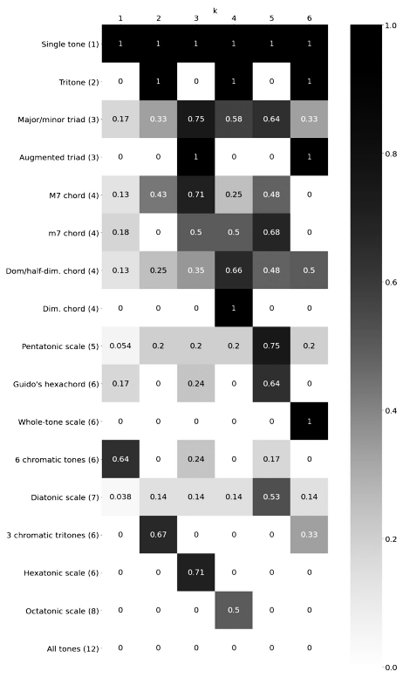
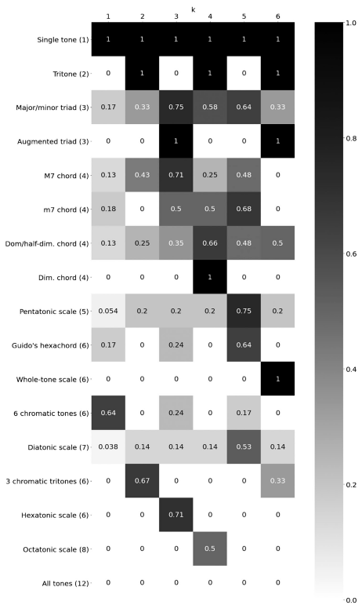

Interpretation of DFT components
III. Methodology
1st: “chromaticity”
2nd: “tritonicity”/”quartality” (Yust, 2015)
3rd: “augmentedness”
4th: “octatonicity”
5th: “diatonicity”
6th: “whole-toneness”
(Amiot, 2016)
(Viaccoz et al., 2022)

Slide 12
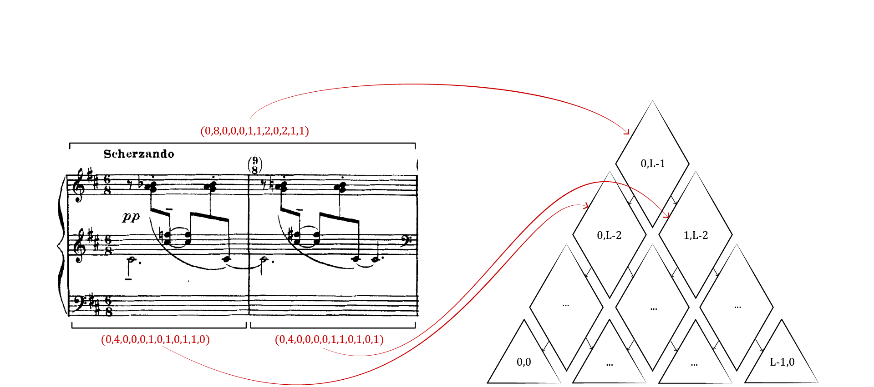
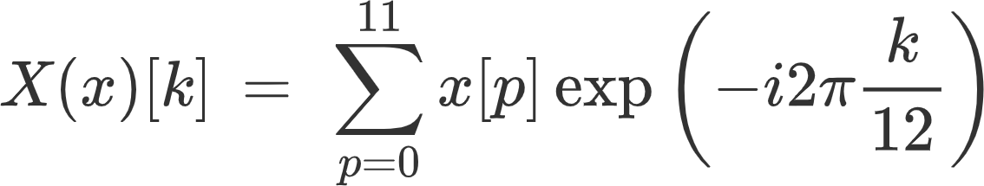
Wavescapes
III. Methodology
Wavescapes: 6 hierarchical graphs representing DFT analyses for every segment of a piece (Viaccoz).
𝜋(n(o,l)) = x(o,l) → each node is mapped to a pitch class vector of notes appearing between o and o+l
X(𝜋(n)) → this is then mapped to the tuple of the DFT of that PCV:

Slide 13
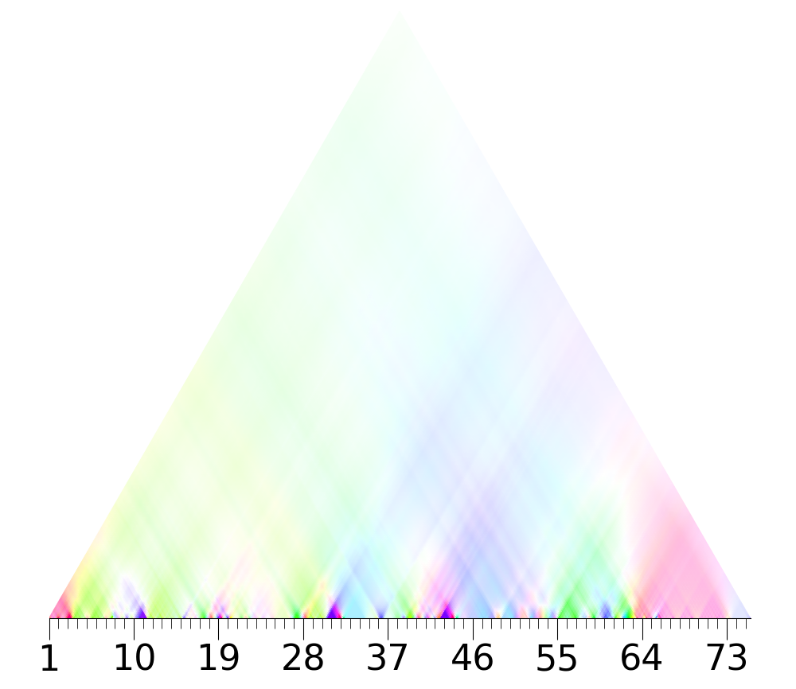
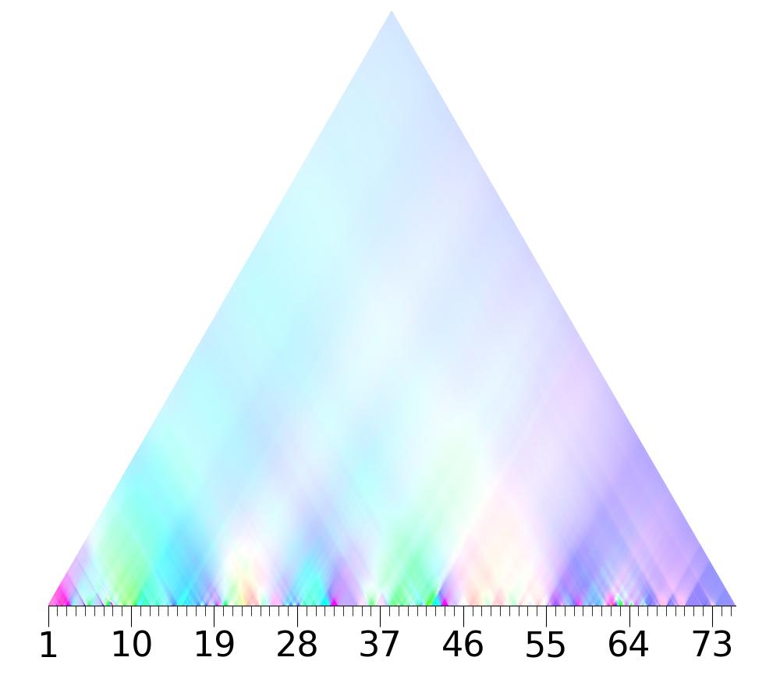
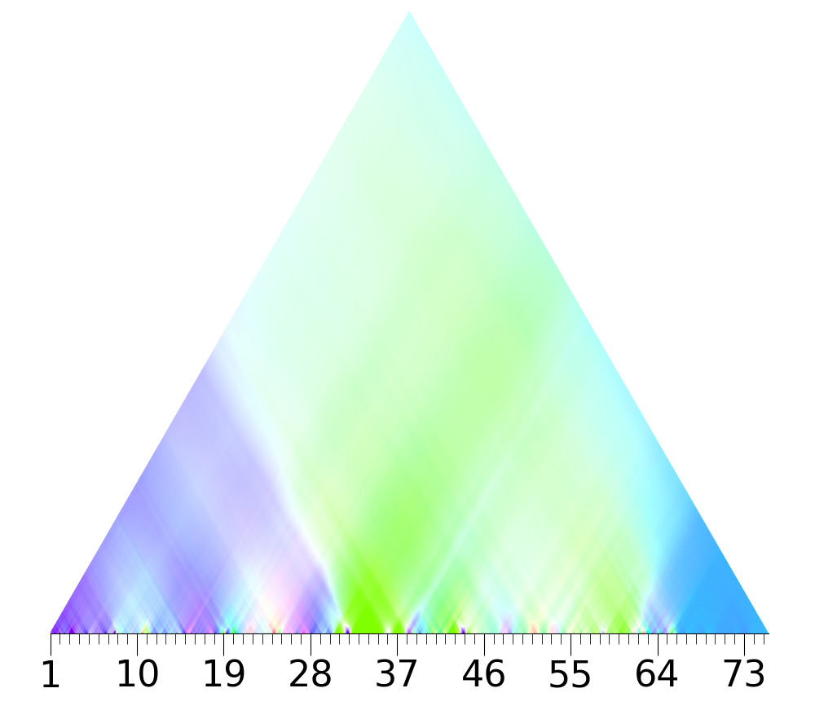
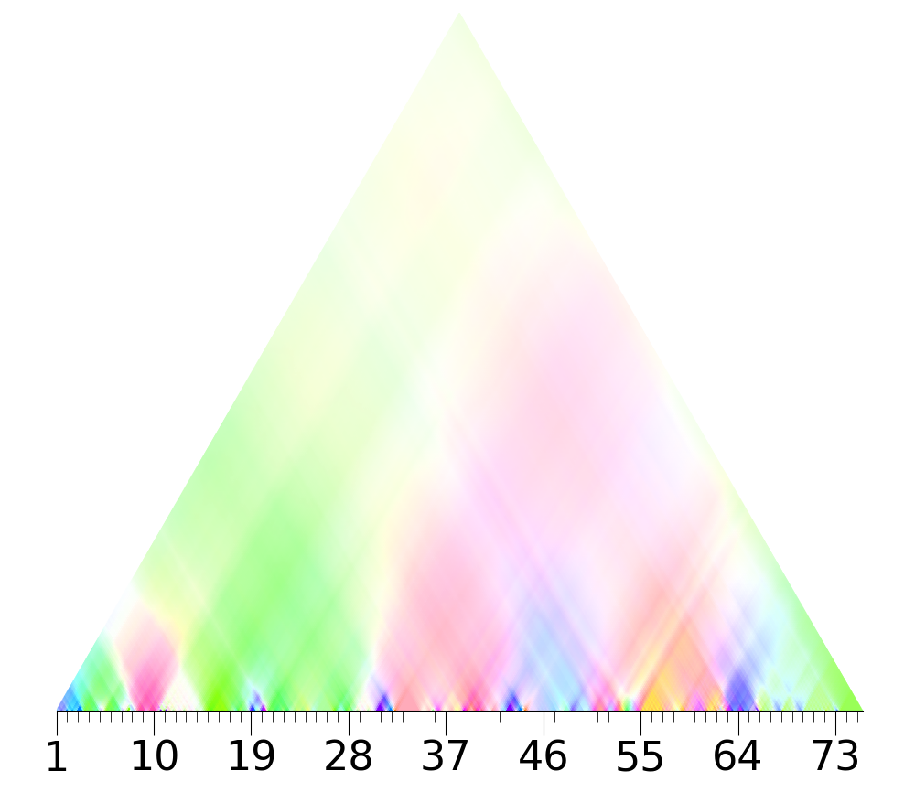
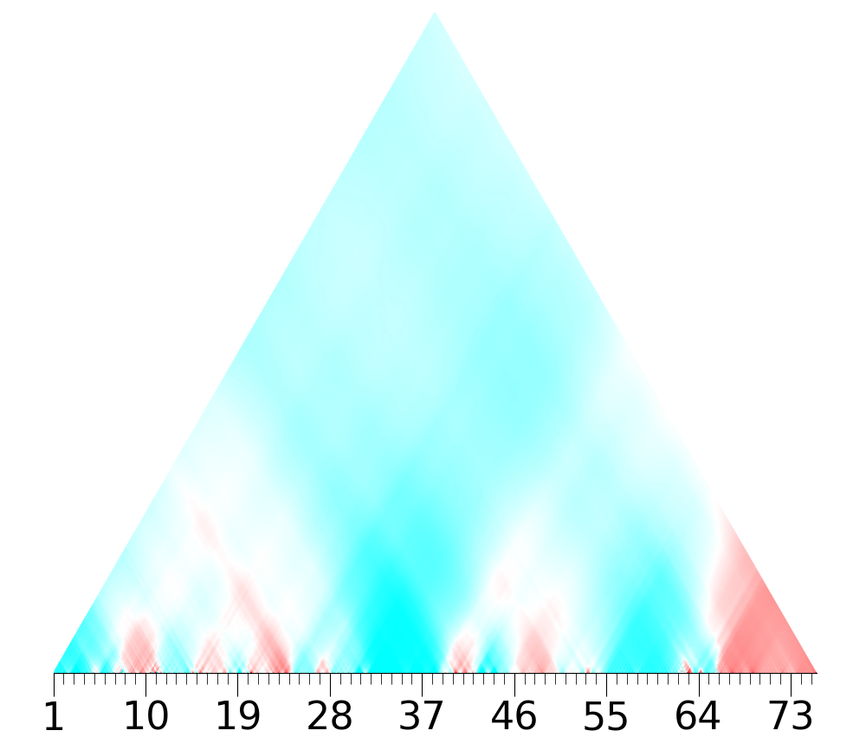
Wavescapes
III. Methodology
6 wavescapes
6 distinct coefficients k → 6 wavescapes
Colour → phase (transposition) ᵩ(x)[k]
Weight → normalised magnitude |X(x)[k]|
1st component
“chromaticity”
2nd component
“tritonicity”
3rd component
“augmentedness”
4th component
“octatonicity”
5th component
“diatonicity”
6th component
“whole-tonedness”
Ondine, Wavescapes

Slide 14
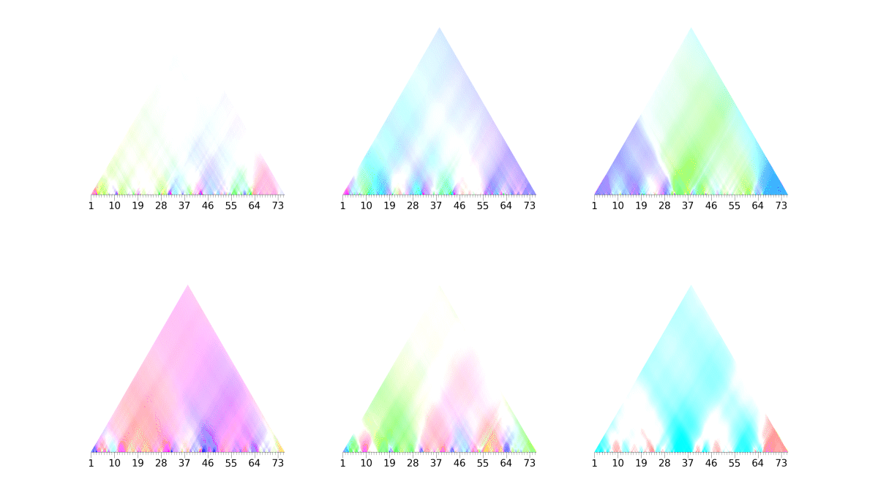
Summary Wavescape
III. Methodology
6 wavescapes
Ondine, Summary Wavescape
6th component
“whole-tonedness”

Slide 15
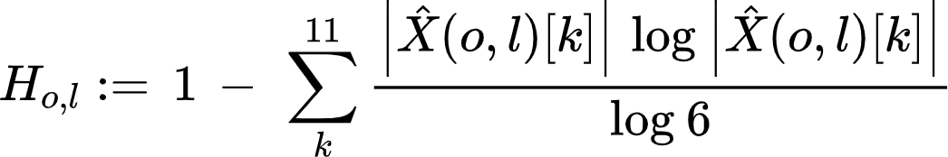
Summary Wavescape
III. Methodology
Aggregates the six wavescapes into one.
colour → strongest DFT component weight → unit complement of entropy of |X(x)[k]| over k

Slide 16
Aims and hypotheses
Introduction
Tracing Debussy’s departure from common practice tonality in terms of ambiguity and fragmentation
symmetric pitch-class materials are increasingly salient, whereas asymmetric diatonic scales are decreasingly salient.
the degree of fragmentation for individual pieces increases over Debussy’s life span, yet…
… the degree of coherence does not decrease

Slide 17
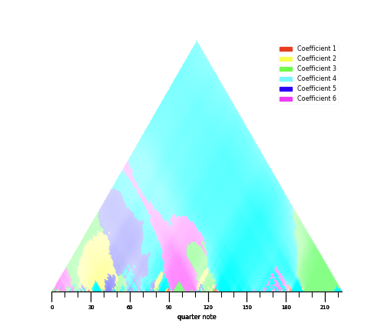
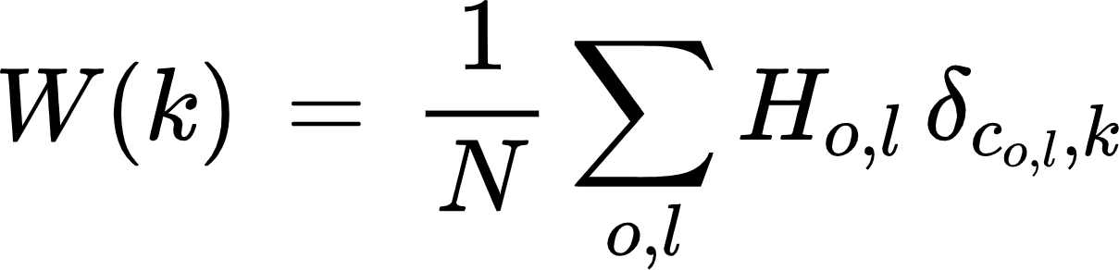
Coefficients’ Prevalence
III. Methodology - Hypothesis 1
The proportion of the summary wavescape’s nodes where the given DFT coefficient has the highest normalised magnitude (unit complement entropy weighting)
δ is Kroenecker’s delta: indicator function of the set of the indices attributed to coefficient k
Prevalence of 4th coefficient: 0.24

Slide 18
Aims and hypotheses
Introduction
Tracing Debussy’s departure from common practice tonality in terms of ambiguity and fragmentation
symmetric pitch-class materials are increasingly salient, whereas asymmetric diatonic scales are decreasingly salient.
the degree of fragmentation for individual pieces increases over Debussy’s life span, yet…
… the degree of coherence does not decrease.

Slide 19
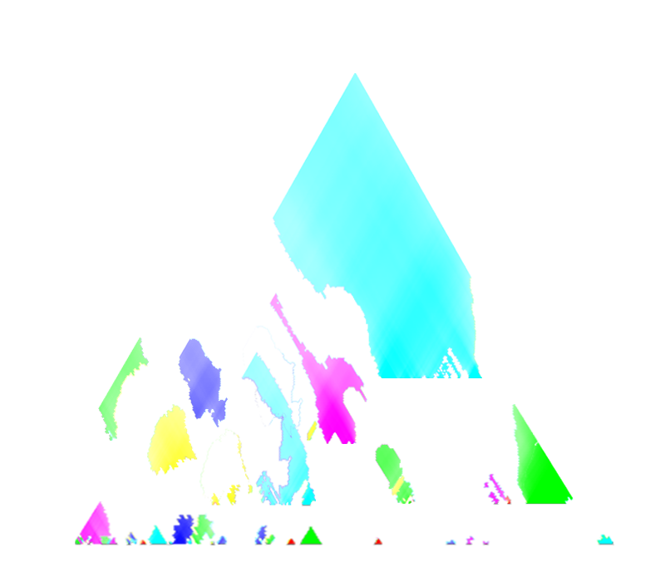
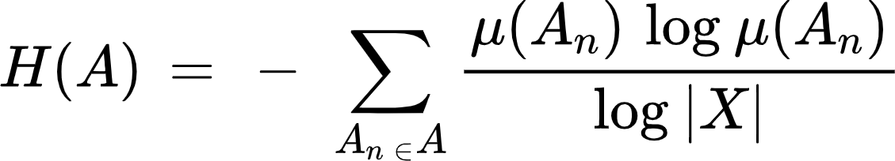
Fragmentation
III. Methodology - Hypothesis 2
Quantifies the degree to which several different pitch-structures govern a piece at different timescales
2-step computation:
Partition → connected components of the graph of nodes with identical labels (on the right)
Fragmentation → entropy of the summary wavescape’s partition:
Fragmentation: 0.12
μ:P(X) →[0,1] is a probability measure s.t. μ(Y)=|Y|/|X|

Slide 20
Aims and hypotheses
Introduction
Tracing Debussy’s departure from common practice tonality in terms of ambiguity and fragmentation
symmetric pitch-class materials are increasingly salient, whereas asymmetric diatonic scales are decreasingly salient.
the degree of fragmentation for individual pieces increases over Debussy’s life span, yet…
… the degree of coherence does not decrease.

Slide 21
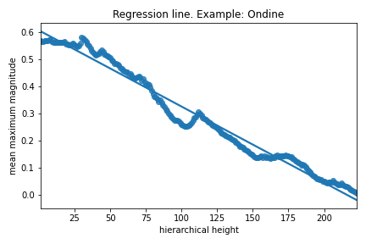
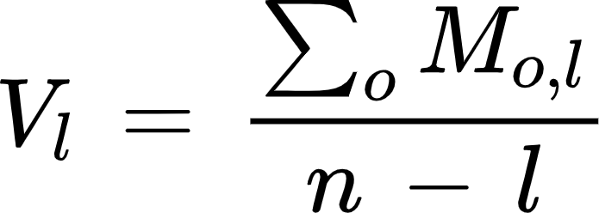
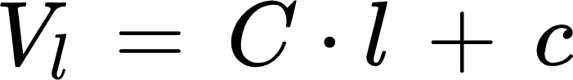
Coherence
III. Methodology - Hypothesis 3
Exceeded expectation of DFT components to decrease in magnitude from bottom to top of the hierarchy.
We compute the mean maximum magnitudes at each hierarchical height.
The coherence is the slope of the linear regression
Coherence C = -0.003

Slide 22
IV. Results
Bayesian mixed-effects models detects the decrease of diatonicity, increase of octatonicity, more fragmentation and non-decreasing coherence

Slide 23
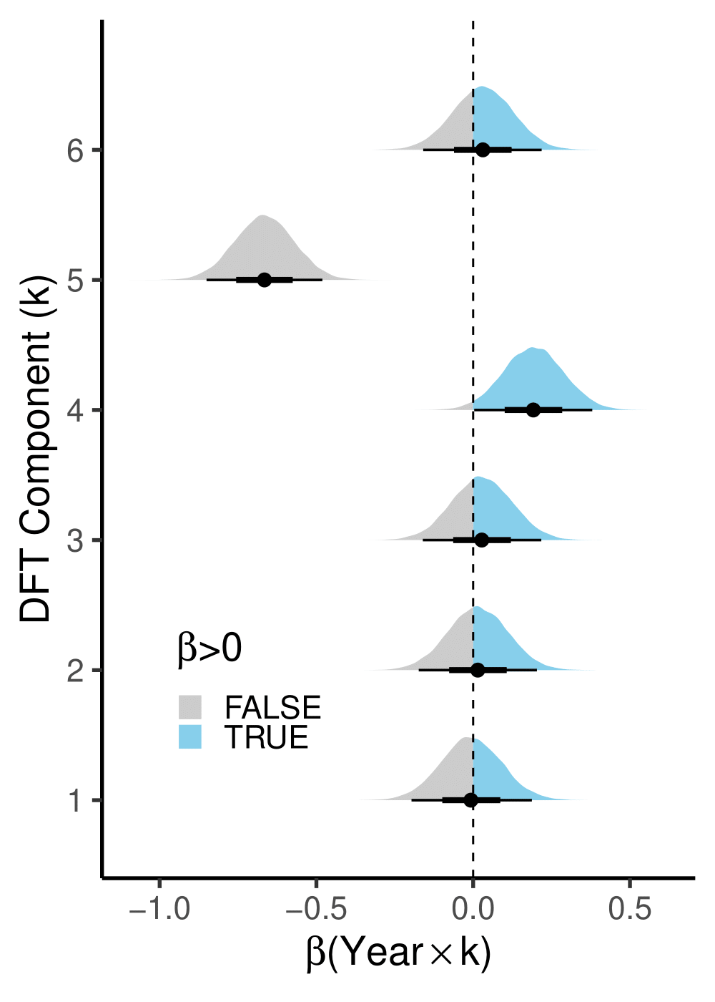
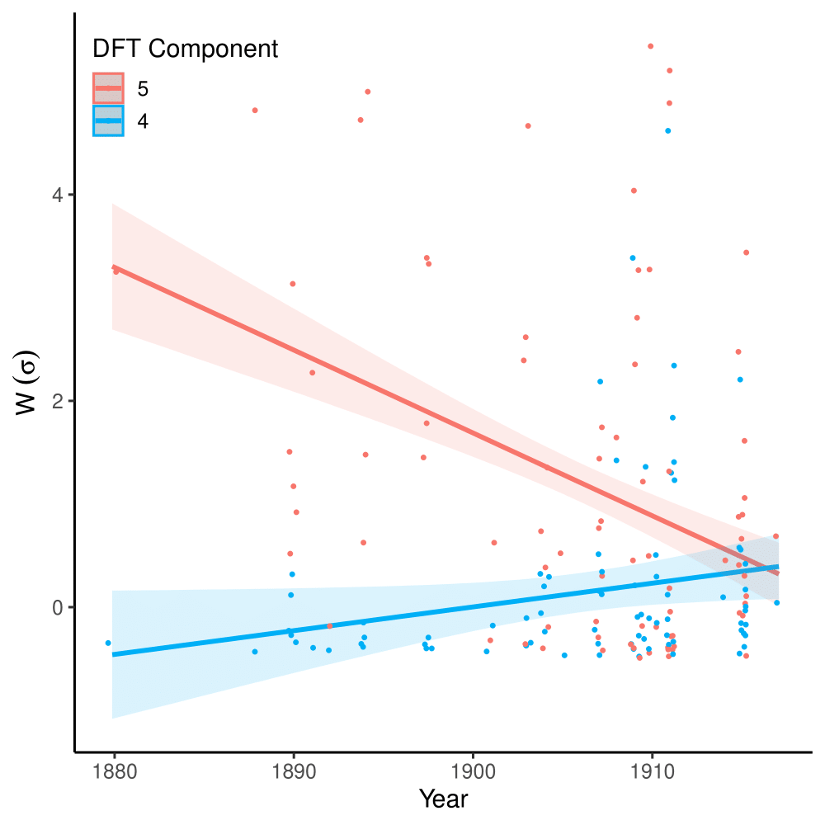
IV. Results - Hypothesis 1
Significant decrease of the 5th component (“diatonicity”)
and increase of the 4th component (“octatonicity”)

Slide 24
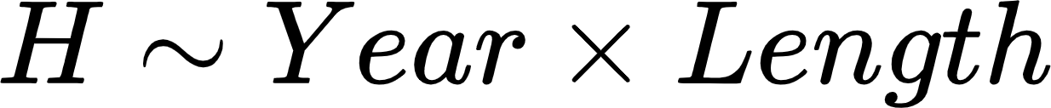
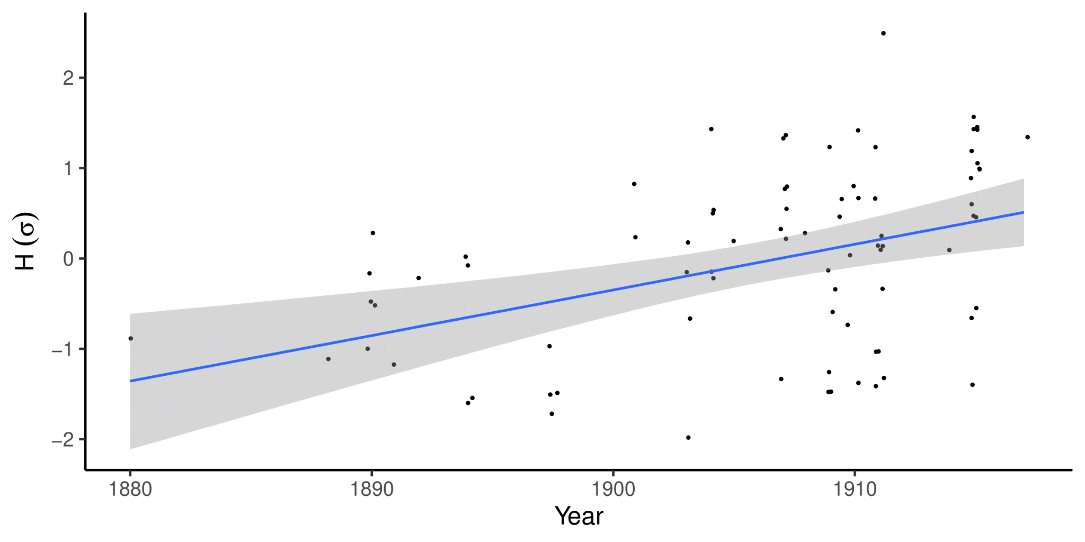
IV. Results - Hypothesis 2
Significant increase in fragmentation

Slide 25
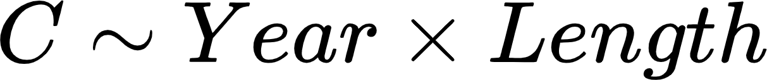
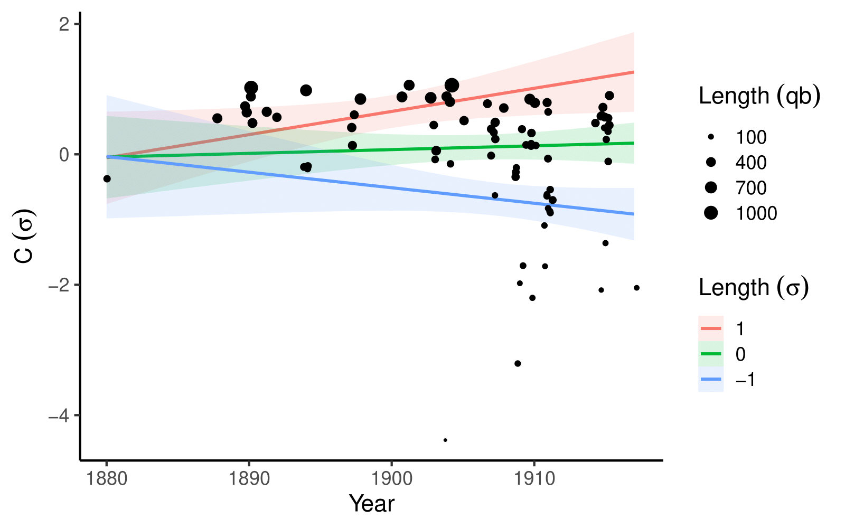
IV. Results - Hypothesis 3
No variation in coherence for pieces of average length.
Significant interaction of year and length: longer pieces increase in coherence over the years more than short pieces

Slide 26
V. Conclusions
Only symmetric structure significantly increasing is the 4th?
Can this highlight some limits of Wavescapes?

Slide 27
V. Conclusions
There is a diachronic evolution in Debussy’s style:
Diminishing diatonicity
Increasing fragmentation
Constant “coherence”
Why is only the 4th coefficient increasing significantly? (cf. Yust 2019)
Limitations of our approach
Opposite transpositions cancel out the magnitudes
Do not separate polyphony

Slide 28
Acknowledgments
My co-authors:
Conservatory G. Verdi, Turin
Sabrina Laneve
Digital and Cognitive Musicology Lab, École Polytechnique Fédérale de Lausanne:
Gabriele Cecchetti
Johannes Hentschel
Martin Rohrmeier
Funding:
Swiss National Science Foundation
EPFL Excellence Fellowship

Slide 29
References
Amiot, E. (2016). Music Through Fourier Space. Springer International Publishing.
Antokoletz, E. (1975). Principles of pitch organization in Bartók's fourth string quartet. Thesis, City University of New York.
Parks, R. S. (1980). Pitch Organization in Debussy: Unordered Sets in “Brouillards.” Music Theory Spectrum, 2, 119–134.
Pomeroy, B. (2003). Debussy's tonality: A formal perspective. In S. Trezise (Ed.), The Cambridge Companion to Debussy (Cambridge Companions to Music, pp. 153-178). Cambridge: Cambridge University Press.
Tobin, A. (2002). Octatonic, chromatic, modal, and symmetrical forms that supplant tonality in five piano preludes by Claude Debussy. PhD thesis, University of Texas.
Viaccoz, C., Harasim, D., Moss, F. C., & Rohrmeier, M. (2022). Wavescapes: A visual hierarchical analysis of tonality using the discrete Fourier transform. Musicae Scientiae, 1–38.
Wheeldon, M. (2004). Interpreting Discontinuity in the Late Works of Debussy. 77, 97–115.
Yih, A. K. (2000). Analysing Debussy: Tonality, Motivic Sets and the Referential Pitch-Class Specific Collection. Music Analysis, 19(2), 203–229.
Yust, J. (2019). Stylistic information in pitch-class distributions. Journal of New Music Research, 48(3), 217–231.

Slide 30
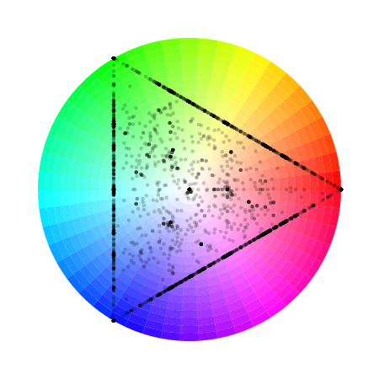
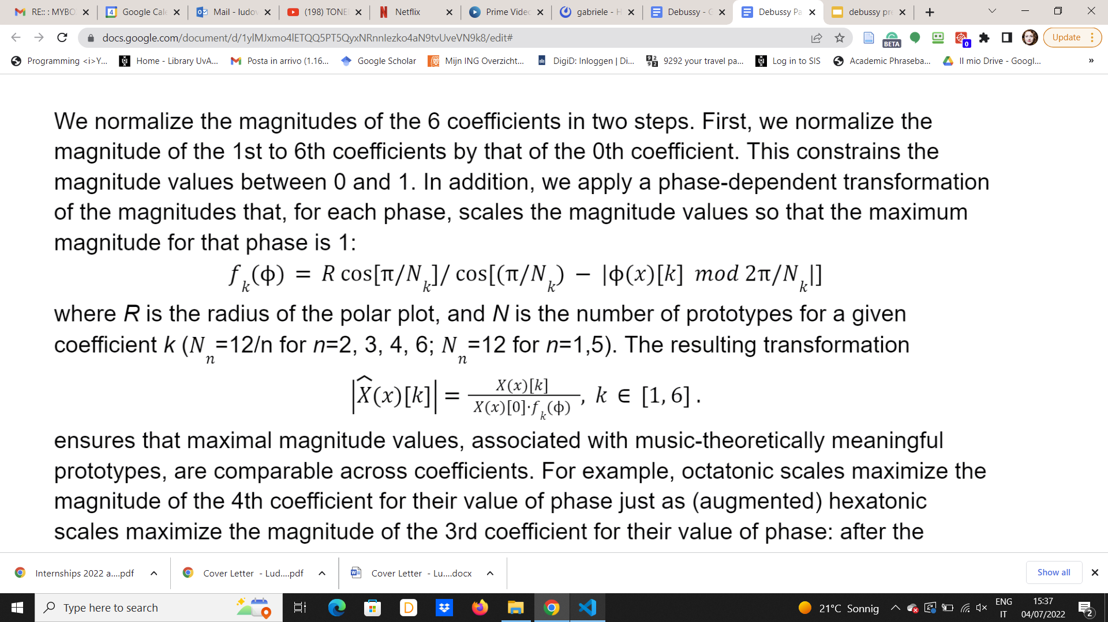
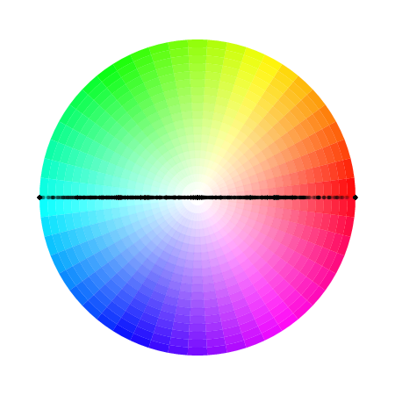
Backup slide: normalisations
III. Methodology
2-step normalisation:
Normalisation by the 0th coefficient
Phase dependent transformation
The transformation uses R the radius of the polar plot and N the number of prototype for coeff k:
← Polar plots of coefficient 4 and 6 from MidiVerto

Slide 31
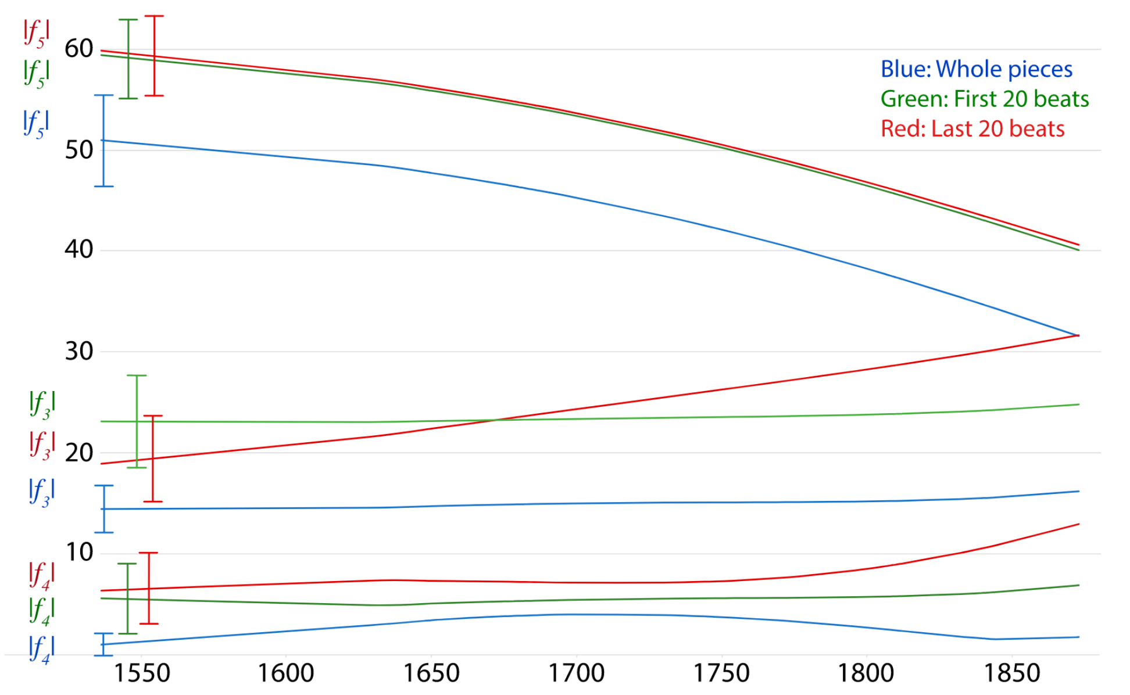
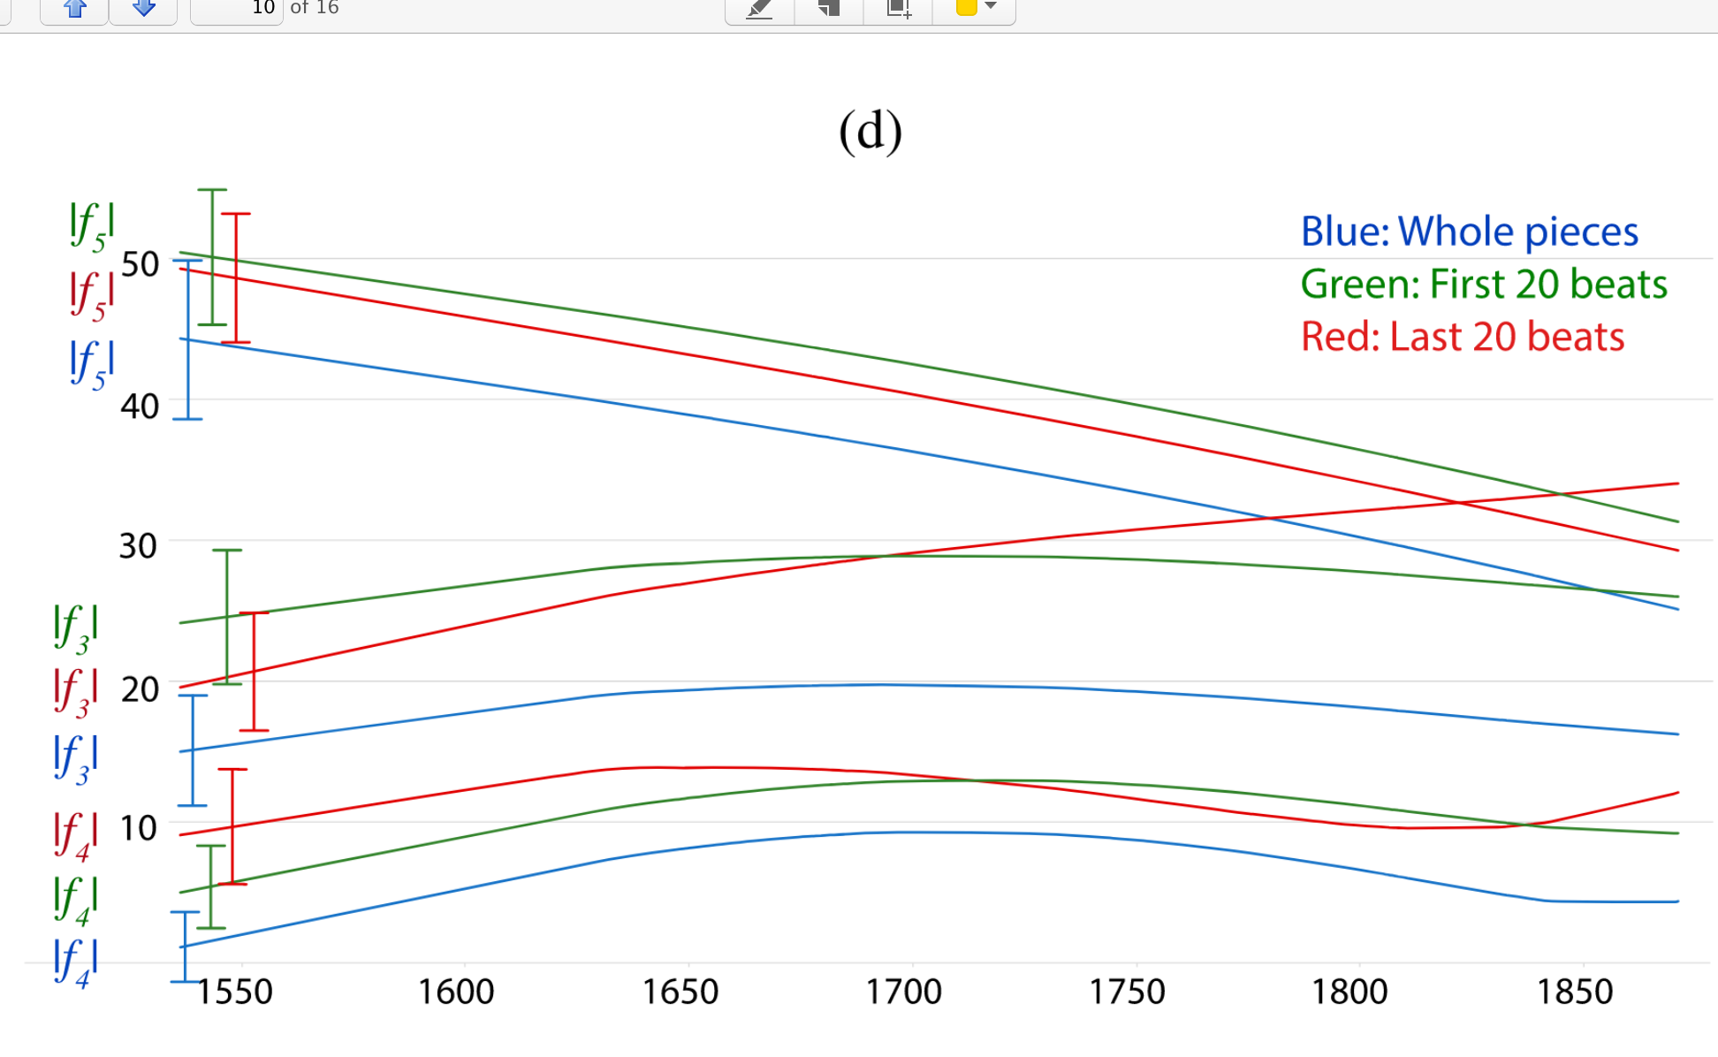
Stylistic evolution and DFT components
III. Methodology
MAJOR
MINOR
Magnitude of coefficients 3,4, and 5 over time (Yust, 2019)

Slide 32
Introduction
Ondine
Dichotomy between natural and supernatural → conflict between the two whole-tone scale poles and between related octatonic segments.
Pitch sets are combined or divided to derive new sets through shared pivotal elements, as a new way of developing harmonic progression.
“one of Debussy's most extreme essays in formal discontinuity.” (Wheeldon)

Slide 33
IV. Results
Diachronic analysis
Bayesian mixed effects model
We include:
main effects (length in quarter note units, metric),
the interaction terms of the fixed terms,
a random intercept over pieces,
a random-slope term

Slide 34
A picture of ambiguity
Introduction
“The pentatonic and modal characteristics that Debussy acquired,[...], are the basis of a more significant tendency toward the breakdown of the traditional tonal system and the formation of a new one based on equal or symmetrical divisions of the octave” (Antokoletz)
“Debussy’s late music shows […] a more refractory than ever approach to syntactical continuity of harmonic practice” (Pomeroy)

Slide 35
Introduction
Ondine (1913) Preludes book II, n. VIII

